Slide 1
Vocabulary Lesson
January 7, 2019

Slide 2
Actual
Happening in fact or reality
The actual cost was far less than we guessed.
Real, true, genuine

Slide 3
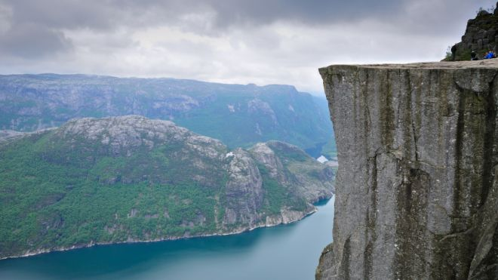
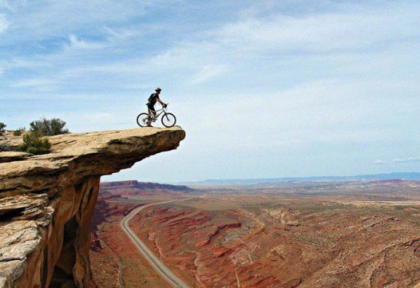
brink
The edge, especially of a high steep place
The hiker stood at the brink of the cliff

Slide 4
chill
An unpleasant feeling of coldness, coolness( noun)
I felt a chill as I skated on the pond.
To make or become cold (verb)
Should we chill the dessert?

Slide 5
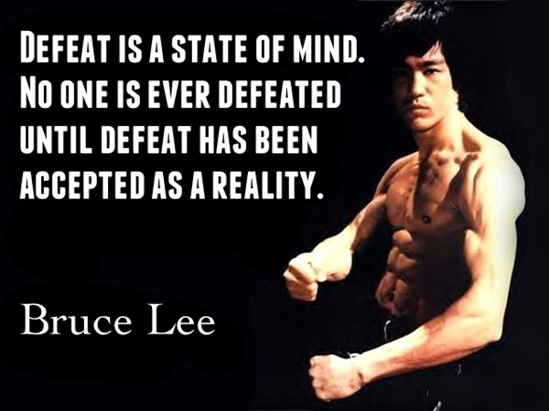
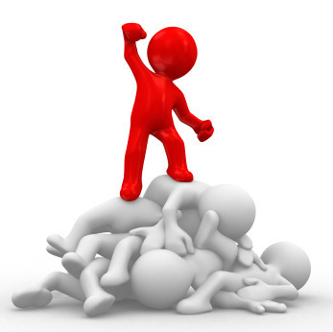
conquer
To defeat or take over, to master or overcome
The army hoped to conquer the enemy quickly.

Slide 6
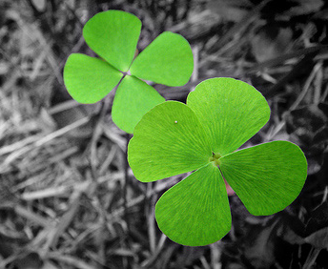
fortunate
Having or bringing good luck, lucky
We were fortunate to have no rain during spring break.
This Photo by Unknown author is licensed under CC BY-NC.

Slide 7
Fury
Strong anger, rage
A bad temper often leads to a state of fury.

Slide 8
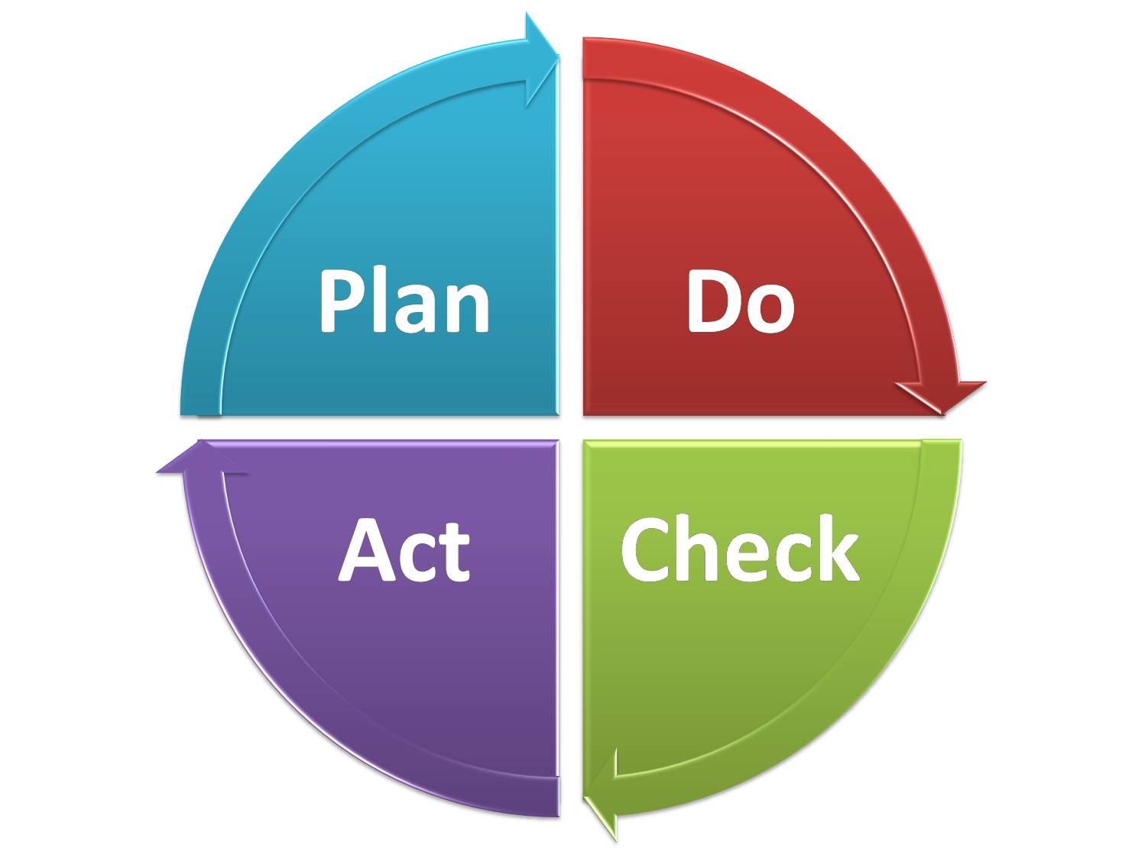
intend
To plan to do something, to have a goal or purpose.
I hope you intend to do your homework this week.

Slide 9
pattern
The way that shapes and colors are put together, a model or guide for making something, a design that is repeated
The striped pattern is the same in each candy cane.
To make or following according to a model or design. ( verb)
I hope to pattern my behavior after someone I look up to.

Slide 10
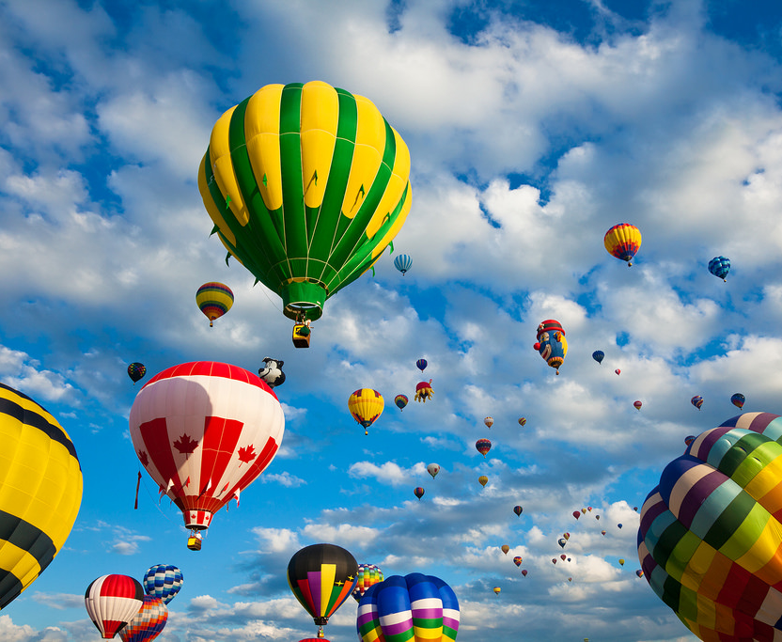
vibrant
Full of life, energy, or activity
Your personality is lively and vibrant, which is why I don't fall asleep in class.

Slide 11
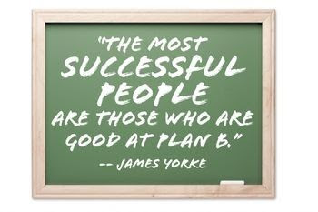
wit
The talent to describe things or people in a funny or unusual way, the ability to think clearly, a clever and amusing person
A teacher with wit often knows how to keep the students' attention in class.

